Slide 1

Notes:
‹#›
Welcome - Kevin

Slide 2
Transition to High School
“I Have a Plan” Work with Ms. Simon
Parent/Student mtg. - Wed., Feb. 14
HS Counselors meet with 8th graders
Activities Fair & Tour in May
GHS Ambassadors next year...
Notes:
Jill

Slide 3
What can parents do??
Promote EXCELLENT attendance
Communicate with teachers/counselors.
Monitor progress on Infinite Campus
Support the school - we want to work “with” you.
Encourage your child to find at least 1 activity/club.
Notes:
Jill
‹#›

Slide 4
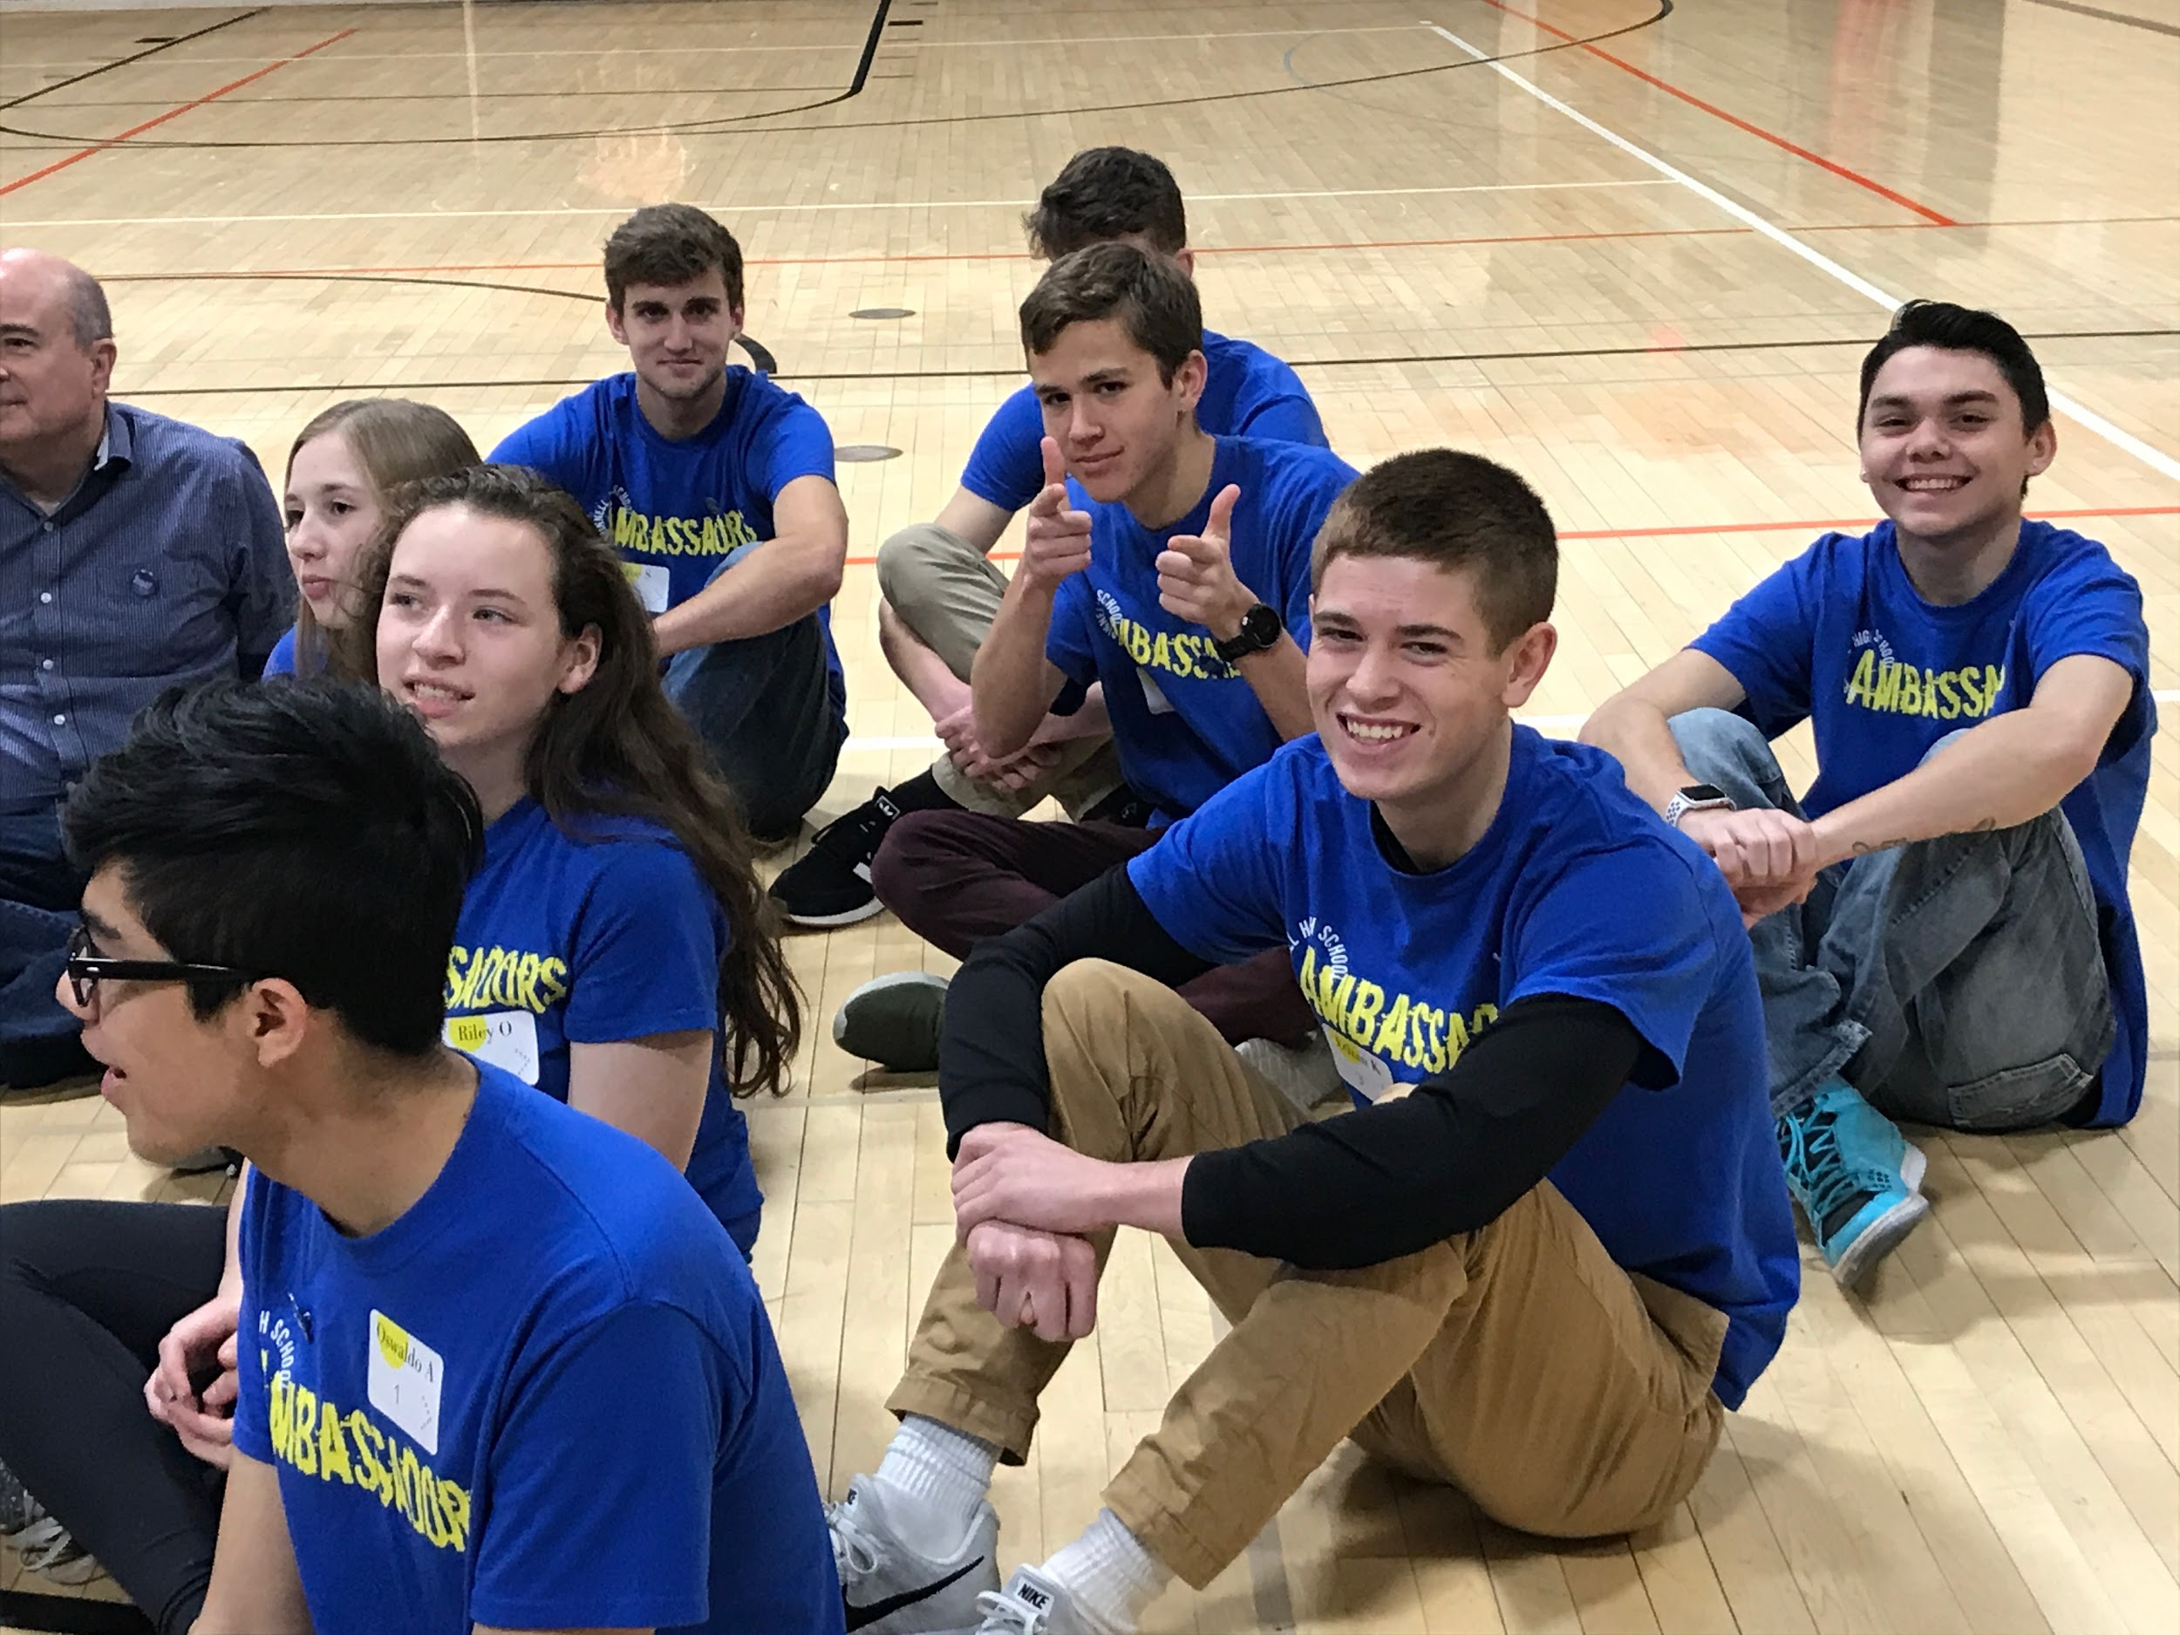
FIND YOUR NICHE
Notes:
Amanda - Activities

Slide 5
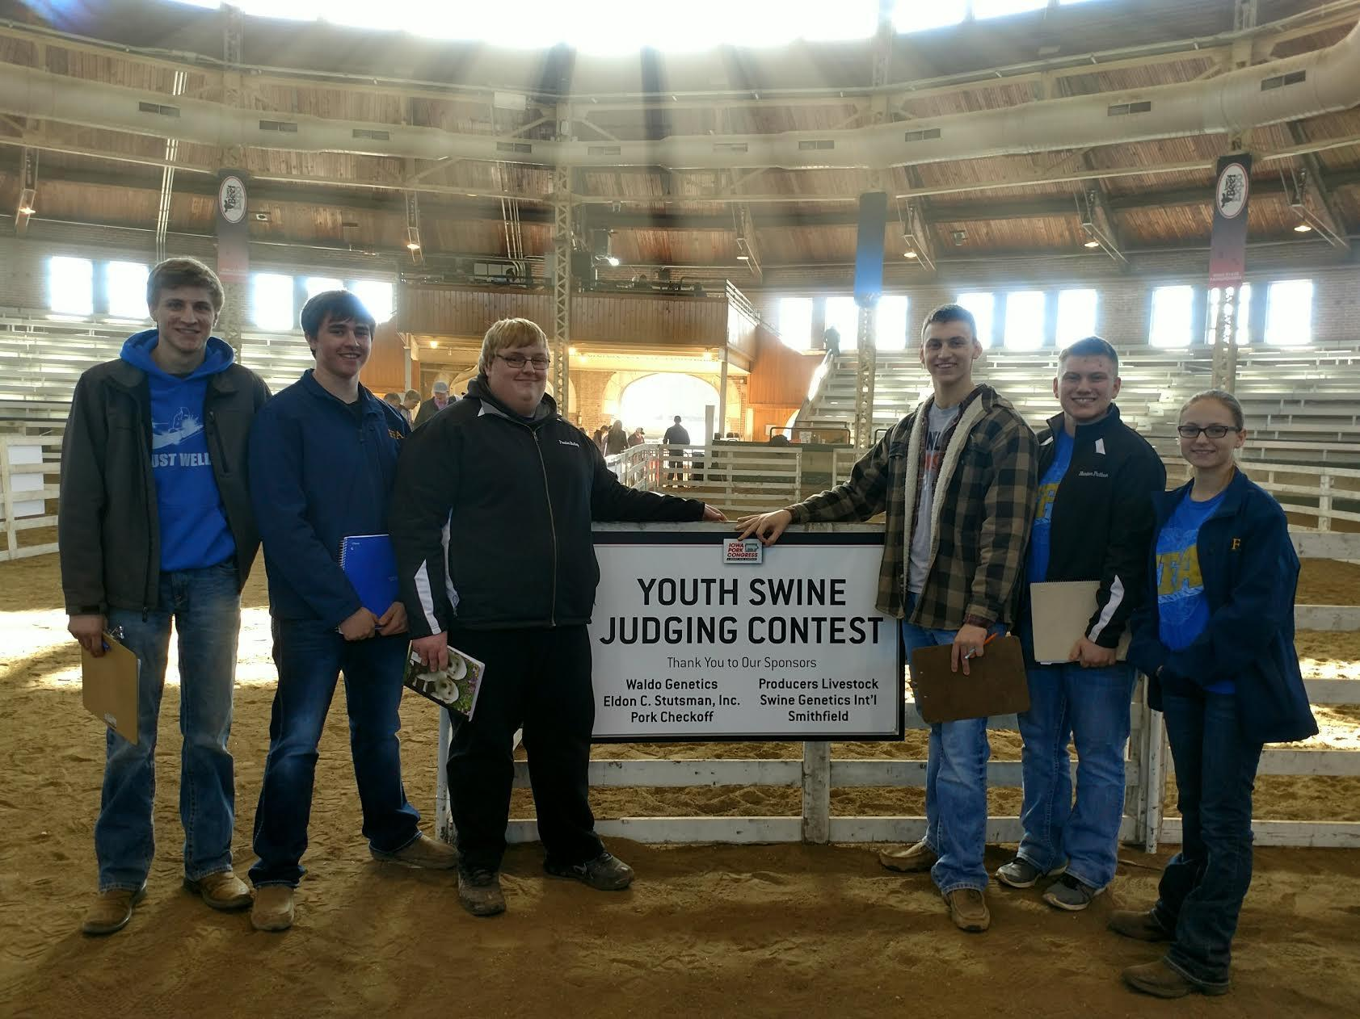
FIND YOUR NICHE
Notes:
Amanda

Slide 6
What’s your
5 YEAR PLAN?
Notes:
Dan

Slide 7
IOWA UNIVERSITIES
Admission Requirements
  Math – Integrated 1, 2, 3
  Science – Chemistry or Physics
  World Language
RAI Score (Class Rank, GPA, Number of core courses taken)
245 = Automatic Admission
Notes:
‹#›
Dan

Slide 8
OTHER OPTIONS
Private 4 year college
  Different admissions policies than universities
Iowa has GREAT Community Colleges
  Approximately half of GHS grads will attend
a Community College
  Learn a Skilled Trade or take Gen Eds for transfer
Apprenticeships
Websites – Check them out!
Notes:
‹#›
Dan

Slide 9
CORE AREA
REQUIREMENTS
Notes:
‹#›
Jill

Slide 10
ENGLISH - 8 CREDITS
9th
  English 9 AB or AXB
10th
  English 10 AB or AXB
11th
  English 11 A & B
12th
  Senior English Capstone
Notes:
‹#›
Jill

Slide 11
ENGLISH - 8 CREDITS
1 additional elective (Check grade levels)
  Print Literacy
  Creative Writing
  Contemporary Novels
  Speech - NEW
  AP Lit & Composition
  Composition 1 & 2 (dual credit)
  Public Speaking (dual credit)
  Creative Writing
  Contemporary Novels
Notes:
Jill

Slide 12
MATH - 3 YEARS
3 years of Math required
  Regents (IOWA, ISU, UNI)
    Must take Integrated 1, 2, and 3 for admission to Iowa Universities
4 years recommended
Course Recommendation from teacher
Look over Sequences
Notes:
‹#›
Amanda

Slide 13
Math Sequences
 | 9th Grade | 10th Grade | 11th Grade | 12th Grade
Sequence 1 | Pre-Int. Math AxB | Int. Math 1A/B Or 1AxB | Applied Math A/B
Sequence 2 | Int. Math 1A/B Or 1AxB | Basic Alg. Skills | Int. Math 2A/B Or 2AxB | Int. Math 3A/B or 3AxB
Sequence 3 | Int. Math 1A/B Or 1AxB | Int. Math 2A/B Or 2AxB | Int. Math 3A/B Or 3AxB | Pre-Calc A/B
Sequence 4 | Int. Math 2A/B Or 2AxB | Int. Math 3A/B Or 3AxB | Pre-Calc A/B | AP Calc AxB
Sequence 5 | Int. Math 3A/B Or 3AxB | Pre-Calc A/B | AP Calc AxB | Calc - GC
Notes:
Amanda

Slide 14
SCIENCE: 6 CREDITS
9th
  Integrated Science A & B
    Must take Applied Physics or Physics A & B before you graduate
10th
  Biology A & B
or
  Applied Physics & Science Exploration
Notes:
Dan

Slide 15
SCIENCE – 6 CREDITS
11th & 12th
  Applied Physics, Biology A & B, Chemistry A & B, Physics A & B, Comparative Anatomy A & B, AP Biology, Adv. Chemistry, Forensics,
Must have Chemistry or Physics to be admitted to UNI, ISU or IOWA
Notes:
Dan

Slide 16
SOCIAL SCIENCES – 7 CREDITS
9th
  US History 1, Global 1
10th
  US History 2, Global 2
        Or - AP US History (3 trimesters)
Notes:
‹#›
Jill

Slide 17
SOCIAL SCIENCES – 7 CREDITS
11th & 12th
  Government or AP Government (2 credits)
  Psychology or AP Psychology (2 credits)
  Sociology
    Students are required to take Psych
    or Soc before graduation
Notes:
‹#›
Jill

Slide 18
SOCIAL SCIENCES
  * All students must take one of the following Capstone Courses:
    Contemporary Global Issues
    AP US History
    AP Psychology
    AP Government
    * Social Studies Electives:
      Economics (11-12)
      Social Sciences in Sports (10-12)
Notes:
Jill

Slide 19
OTHER REQUIREMENTS
Physical Education - 4 years
Health - 9th grade
Financial Literacy or Economics-Junior or Senior year
53 credits required
Counselors will review/check credits with all juniors & seniors in an individual meeting.
Notes:
Jill

Slide 20
BUSINESS EDUCATION
Intro to Business (9-12)
Marketing (10-12)
Accounting (10-12)
Advanced Accounting (11-12)
Business Law (11-12)
Financial Literacy (11-12)
Business Internship (12) (for dual credit)
Notes:
‹#›
Amanda

Slide 21
FAMILY & CONSUMER SCIENCES
Life Responsibilities (9-10)
Culinary Arts 1, 2, & 3 (9-12) - Culinary 3 = 2 periods
Interior Design (9-12)
Fashion Design (9-12)
Child Development 1 (10-12)
Child Development 2 (11-12)
Independent Living (12)
Notes:
‹#›
Amanda

Slide 22
MANUFACTURING TECHNOLOGY
Intro to Manufacturing (9-12)
Manufacturing Production (10-12)
Home Maintenance (9-10) - NEW
Energy & Power (10-12)
Welding (10-12)
Welding Certificate (11-12) (for dual credit)
Notes:
‹#›
Dan

Slide 23
AGRICULTURE
Intro. to Ag & FFA (A & B)
Plant Science
Soil Science
Intro to Animal Science
Survey of the Animal Industry (dual credit)
Ag. Leadership
Notes:
‹#›
Dan

Slide 24
WORLD LANGUAGE
Spanish 1
Spanish 2
Spanish 3
Spanish 4
Two years of the same language required for admittance to some universities.
Notes:
‹#›
Jill

Slide 25
VISUAL ARTS
Art Foundations
Intro to Drawing
Intro to Painting
Digital Photo 1
Digital Photo 2
Notes:
Jill

Slide 26
VISUAL ARTS
3D Design
Printmaking
Ceramics (dual credit)
Drawing (dual credit)
Painting (dual credit)
Notes:
Jill

Slide 27
MUSIC
Band
  Register for ALL 3 Trimesters
Varsity Choir
  Register for ALL 3 Trimesters
Concert Choir
  Register for ALL 3 Trimesters
Notes:
Amanda
‹#›

Slide 28
OTHER ELECTIVES
Health Advocacy
Intro to Computer Science
AP Computer Science Principles A&B
Yearbook
Notes:
Amanda
‹#›

Slide 29
EARN COLLEGE CREDIT
Dual credit (high school & college)
Juniors & Seniors
Iowa Assessment scores/growth & daily attendance are used as criteria
Courses taught at GHS and at Iowa Valley-Grinnell
Notes:
‹#›
Dan

Slide 30
EARN COLLEGE CREDIT
Advanced Placement Courses
  Biology, Government, US History, Psychology, Calculus, English, Computer Science
  Grades are weighted x1.1 (B - 3.0 x 1.1 = 3.3)
  AP Tests in May
Grinnell College - Adv. Scholars program
  Application process
Notes:
Dan

Slide 31
FRESHMAN ELECTIVES
Spanish 1 A & B
Band (3 Trimesters)
Varsity Choir (3 Trimesters)
Intro to Ag A & B
Art Foundations
Digital Photography 1
Notes:
Jill

Slide 32
FRESHMAN ELECTIVES
Intro to Business
Intro to Computer Science
Print Literacy (English Credit)
Life Responsibilities
Culinary Arts 1 (unless sections fill with upperclassmen)
Notes:
Jill

Slide 33
FRESHMAN ELECTIVES
Interior Design
Fashion Design
Intro to Manufacturing
Home Maintenance
Applied Physics (Science Credit)
  take this or Physics A/B sometime before graduation
Notes:
Jill

Slide 34
Mock Schedule
Tri 1 Tri 2 Tri 3
E2 | E2 | E2 | E2
Per 1 | English 9A | Health | English 9B
Per 2 | Int Math 1AXB | Int Math 1AXB | Int Math 1AXB
Per 3 | US History 1 | Study Center | Global Studies 1
Per 4 | Study Center | Int Science A | Study Center
Per 5 | Team Sports | Intro to Manufacturing | Int Science B
Per 6 | Varsity Choir | Varsity Choir | Varsity Choir
Notes:
Dan

Slide 35
REGISTRATION PROCESS
GO TO HIGH SCHOOL WEBSITE
ACADEMIC TAB
Notes:
Amanda

Slide 36


Slide 37
END

Slide 39
More about High School
  Challenge yourself - Do you need more than 1 Study Hall per trimester?
  Trimester Test days each trimester
    Schedule
    Open Campus
  Switching from JMC to Infinite Campus
Notes:
Kevin

Slide 40
ACADEMIC LETTERS/PINS
Academic Letter
  3.5 GPA for 6 trimesters
    Doesn’t have to be consecutive
Academic Pin
  3.5 GPA for 7 or more trimesters
Notes:
shelly

Slide 41
Friday @ the MS
Math Recommendation will be given to you
What elective classes do you want?
13-14 classes minimum, 18 classes maximum
If you have an IEP, you will have help with your schedule at your IEP mtg.
Notes:
Jill
‹#›

Slide 42
MORE ON GPA’S
  GPA’s are figured at the end of every trimester for Honor Roll
    Honor Roll - 3.25
    High Honor Roll - 3.75
  Cumulative GPA
    Honor Grad - 3.50
    High Honor Grad – 3.75
    NHS eligibility - 3.75
Notes:
‹#›
shelly

Slide 43
Activity Eligibility in HS
Activity Eligibility – Follow ‘state’ rules
Good Conduct Policy
  Must pass all courses at the end of the trimester
  Students may still practice with the team/group and are encouraged to do so.
Notes:
kevin

Slide 44
Always do your BEST!
  Academic Excellence Awards Ceremony
    9th -- 4.0 cumulative GPA
    10th -- 3.95 cumulative GPA
    11th -- 3.90 cumulative GPA
    12th – 3.85 cumulative GPA
  Pride Assemblies
    Grade Point Improvement Awards
    Academic Letters, etc.
Notes:
‹#›
Kevin

Slide 45
DO YOU KNOW HOW TO FIGURE YOUR GPA?
Grade Point Average
  Grade points divided by number of credits
Int. Math 1 B 3.00 pts.
9th English C+ 2.33 pts.
US History A- 3.67 pts.
Earth Science B- 2.67 pts.
Art Found A 4.00 pts.
15.67
15.67 divided by 5 credits = 3.134 GPA
GPA’s are not rounded up - exact number
Notes:
Jill

